Slide 1
Miami Data Science Meetup jim.crozier@ibm.com github: jimcrozier twitter: crozierrj linkedin: linkedin.com/in/jimcrozier
Notes:
3 Slides:
- What?
- Why?
- How?

Slide 2
If you nothing else out of this
Data is getting huge, some tools help
Hack it till you make it:
1. there are lots of tools out, use them for their best use
2. R is great tool for using tools
Working with sparklyr

Slide 3
1Zb
25 Years
1Zb
4 Months
? Zb
Next 25 Years

Slide 5
Virtualized In-Memory Layer
Worker Node
Distribute the data across workers to increase time and efficiency for in-memory solution
10x-100x efficiency increases from other methods that can handle large data
Master Node
Worker Node
…
Worker Node

Slide 7
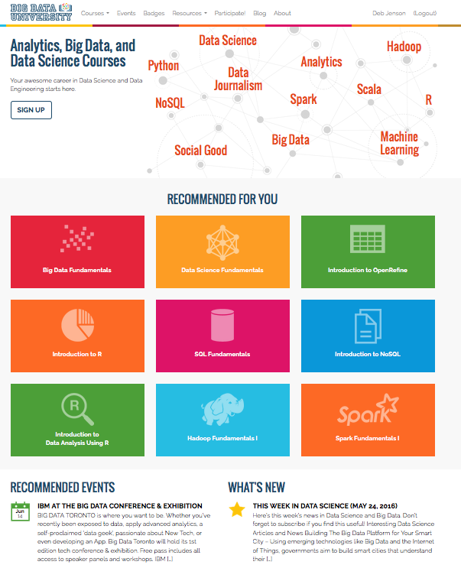

IBM is committed to training over 1 million data scientist over the next few years
IBM DATA SCIENCE EXPERIENCE
ALL YOUR TOOLS IN ONE PLACE
datascience.ibm.com
bigdatauniversity.com

Slide 8
Overview dplyr and sparklyr

Slide 9







IBM BigInsights

